Slide 1
General Terms and Conditions of Works of External Companies Carried-Out in the Objects of the Company Robert Bosch ČB
Lenka Nechanická, RBCB/HSE
www.bosch.cz/cb (download documents - Instructions for external companies)

Slide 2
Table of contents
Instructions for external companies
1.) Legislation 13.) Ladders
2.) Directives for external companies 14.) Lifting equipment
3.) General requirements 15.) Lifting equipment (platforms)
4.) Chemical substances 16.) Handling of Bulky Loads
5.) Wastes 17.) Charging station
6.) Emergency 18.) Works on electrical equipment
7.) Alcohol 19.) Explosion hazard premises - EX
8.) Personal protective equipment
9.) Work accidents
10.) Medicine cabinets
11.) Traffic Operating Rules
12.) Works at height

Slide 3
1.) Legislation
Instructions for external companies
The employer shall be obliged to ensure health and safety of employees at work with regard to the risk of possible threat to their lives and health, related to the work performance (§ 101 (1) of the Labour Code No. 262/2006 Coll.).
The individual senior managers shall be responsible for fulfillment of tasks of occupational health and safety to the extent of their functions and powers. These tasks shall be an equal and inseparable part of their job duties (§ 101 (2) of the Labour Code No. 262/2006 Coll.).
At the same time, each employee shall be obliged to take care of his safety, health and safety and health of persons directly affected by his activities, and/or negligence at work (§ 106 (4) of the Labour Code No. 262/2006 Coll.) as far as possible.

Slide 4
Instructions for external companies
If employees of two and more employers fulfil tasks at one workplace, the employers shall be obliged to inform one another in writing about risks and measures taken to protect against exposure to the risks associated with the work being done and with the workplace concerned, and shall cooperate in ensuring the occupational safety and health protection for all employees at the workplace. Based on a written agreement between involved employers, the employer (authorized by the said agreement) shall coordinate actions for protection of safety and health of employees as well as procedures to ensure the same.
Each employer, mentioned in the previous paragraph, shall be obliged to:
  ensure that his activities and works of his employees shall be organized, coordinated and carried-out in a manner to protect also employees of another employer,
  sufficiently and without undue delay inform trade unions and representatives of employees for occupational health and safety, and if not active at the employer, directly his staff about risks and adopted measures obtained from other employers.
The employer's obligation to ensure occupational health and safety at work shall apply to all persons who are in workplace.
All works shall be carried-out in harmony with valid regulations and internal RBCB regulations.

Slide 5
2. Directives for external companies
Instructions for external companies
RBCB – the company Robert Bosch spol. s r.o., České Budějovice
External company (EC) - a company active in the RBCB objects as authorized by the RBCB.
EC coordinator - a RBCB employee, trained and appointed in writing, supervising and coordinating works of Ecs in the RBCB objects.
Authorized representative of the EC - an EC employee, authorized by the EC to check and supervise works carried-out in the RBCB.

Slide 6
Instructions for external companies
Obligations of external company:
  to the full extent guarantee professional qualification (updated professional qualification documentation) and compliance with safety instructions by its staff.
  to appoint the authorized representative of the EC provided that the EC carries-out works on the equipment and property in the RBCB premises.
  to cooperate with the relevant EC coordinator.
  to confirm the form Responsibility of External Companies. The executive of the EC (or the representative authorized by the executive) shall sign this form at the time of the signature the agreement; shall be ensured by the RBCB procurement department and/or the EF coordinator.

Slide 7
Instructions for external companies
Form “Responsibility of External Companies”
  By signing this document, the external company (supplier) shall undertake to comply with rules of works carried-out in the RBCB objects mentioned in the manual “General Terms and Conditions of Works of External Companies Carried-Out in the Objects of the Company Robert Bosch spol. s r.o.”, available on the Internet, see reference in this form. Each employee accessing the RBCB, including employees of sub-suppliers with contractual relation with the supplier and working under the supervision of the supplier in the RBCB, shall be trained according to this presentation.
  Compliance with legal regulations shall not be excluded from obligations.
  To ensure cooperation and coordination of works, the external company shall be obliged to appoint an authorized representative of the EC, who shall be responsible for compliance with mentioned requirements. The EC coordinator for external companies, appointed for works carried-out in the specific sector, shall be his partner from the RBCB.
  If the EC employee and his work breaches his obligations defined in this presentation, the EC coordinator and/or his representative may suspend such work until redress, order the EC employee intoxicated by alcohol and/or intoxicating substances out of the plant or terminate cooperation with the EC.

Slide 8
Instructions for external companies
Basic obligations of the authorized representative of the EC:
  Before the EC enters the RBCB, to fill in and sign the form “Handover of the workplace to an external company including mutual exchange of information on risks”.
  To inform the EC coordinator about presence of the EC in the company before entering the RBCB object.
  Before the start of work, to fill in the form “Handover and takeover of the workplace to an external company ”; if necessary, risks/measures associated with the specific work shall be completed, allow work permits (next page). In cooperation with the EC coordinator to introduce every measure at the workplace necessary to eliminate hazard to staff, environment and property.
  To forward information about specific conditions of work performance to all his employees including staff of sub-suppliers.
  After the completion of works, to fill in the form “Handover and takeover of the workplace to an external company ” together with the EC coordinator and/or his representative.

Slide 9
Instructions for external companies
Hot work permits shall be needed for:
  open flame work, welding, flame cutting, soldering and grinding with fire hazard from heat and sparks, roof repairs with burner etc.,
  works in the explosive environment - order “V”,
  works with cranes, lifting equipments (point 14-15),
  Order “B” shall be filled in for works on electrical equipment low-voltage, very-high voltage and extra-high voltage.
  Obligations of the authorized representative of the EC and EC coordinator for implementation of the “hot work permits”
  For the so-called “Hot work permits”, the authorized representative of the EC and the EC coordinator shall fill in the necessary authorizations. The authorized representative of the EC shall deliver information about specific conditions of the work performance to all his colleagues and all staff of sub-supplier carrying-out works in the RBCB. The EC staff may not carry out works without delivery of such information.

Slide 10
3.) General provisions - general terms and conditions
Instructions for external companies
  Admission/exit and access/leave to/from the RBCB shall only be allowed through entries and gates reserved for such purpose. A person shall be obliged to submit to inspections of belongings brought or taken with him.
  Prohibition of the introduction of weapons.
  Switching on and off of all media or their parts by the network (sprinklers, power supply, gases, fire detection and fire-alarm system etc.) shall be allowed either in the presence of FCM staff and/or on the basis of prior written permission. Similarly, the EC staff shall be obliged to report completion of such works. If fire detection and fire-alarm system or sprinklers are activated through the EC fault, incurred costs shall be charged to the EC (for example, false alarm to the fire rescue service).
  If necessary, FCM staff shall introduce the authorized representative of the EC to technical and technological equipment (sprinklers, fire detection and fire-alarm system, cooling systems, air conditioning etc.) where unprofessional intervention might cause serious damages.
  Cranes, Lifting equipment – point 14-15
  Admission of children under 15 years of age into the plant shall be forbidden.
  Drivers of trucks and/or personal vehicles shall not be allowed to refuel these cars inside the RBCB.
  EC - remote administration of MAE (machines) - necessary to inform in advance with the security rules for remote administration for MAE.

Slide 11

Instructions for external companies
  Consent from the FCM department shall be necessary to drill walls or columns.
  The equipment under work shall be labelled with safety warning sign (for example, “Out of Operation”).
  Movement along the assigned workplace only. The EC staff shall be entitled to move only in those parts of the RBCB where the staff shall carry-out its job duties. Only spaces (changing room, washing room, WC, storage etc.), showed to the EC together with the hand-over of the workplace, shall be used.
  The EC shall be forbidden to use company canteen (according to manager AL of the coordinator).
  Employees of external companies, working in the RBCB, shall carry logos of their companies
  and ID card visibly, if it is safety while working.
  Use of any equipment and machinery owned by the RBCB, to which the EC staff has not been introduced (training on the instructions, risks etc.) shall be prohibited.
  Works on live low voltage circuits shall be forbidden in the RBCB.
  Unconditionally respect the established ban on smoking in workplaces. The ban on smoking will apply in all premises and on all RBCB-owned land as well as leased properties, indoors and outdoors (except for places designated for this purpose). The ban on smoking will apply to cigarettes, cigars as well as all types of electronic cigarettes.
  The EC staff shall not enter the RBCB premises intoxicated with alcohol or intoxicating substances and shall not bring such substances into the premises.

Slide 12


Instructions for external companies
  Before leaving check the status of the workplace, switch off or disconnect electrical appliances if it is required in accompanying documentation of the producer.
  Check that there are no obvious sources of fire in the workplace, for example flammable material near heat sources, switch on cookers, lights on etc.
  Do not use headphones or other similar devices (excluding personal protective equipment – protection of ears and head set for working teleconferences).
  It is prohibited to make video and audio recordings.
  It is prohibited to use recording devices including dash cameras in vehicles.

Slide 13
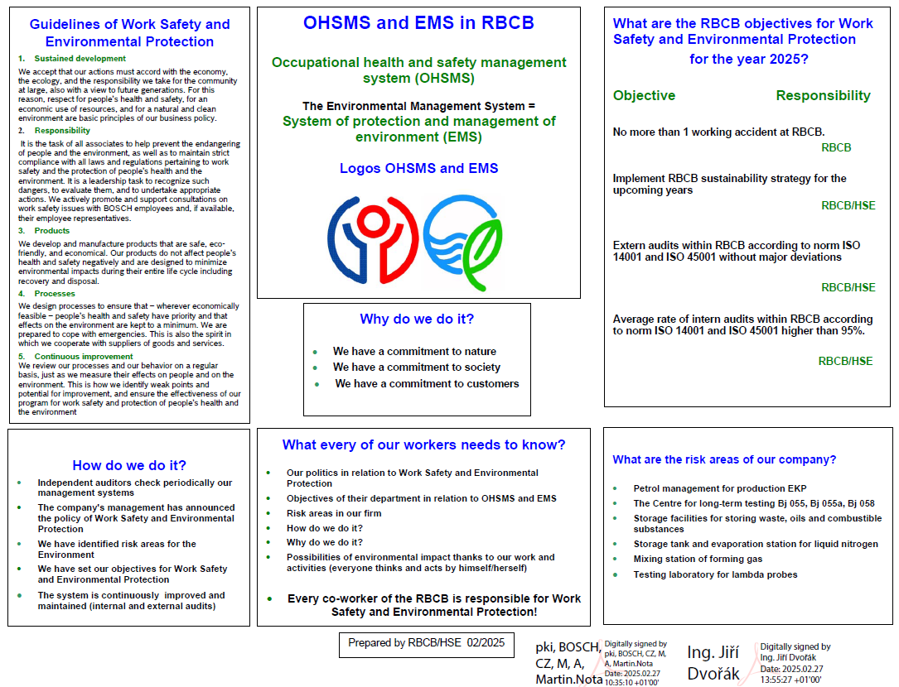
Instructions for external companies

Slide 14

4.) Chemical substances and mixtures (CHSM)
Instructions for external companies
The EC shall comply with all legal regulations in handling of chemical substances and mixtures (CHSM).
The EC shall be obliged to report use of hazardous CHSM to the HSE through the EC coordinator and deliver safety data sheets in the Czech language.
Obligations of the EC:
  Keep files of CHSM.
  Provide CHSM documentation.
  Provide means for prevention/elimination of emergencies.
  Leakage of CHSM shall be prevented during transport in the RBCB and CHSM must be properly stored.
  Food packaging shall not be used to handle CHSM.
  CHSM and foods shall not be stored together.
  Don 't eat and drink during work.

Slide 15
Instructions for external companies
  Personal protective equipment shall be used to handle CHSM.
  In case of CHSM leakage (emergency), the EC coordinator shall be informed immediately.
  Pressure vessels shall be properly secured against falling.
  Replacement packages shall be labelled.
ECs without permanent workplace in the RBCB, but disposing with their own CHSM, shall be obliged to report the use of CHSM in the RBCB to the EC coordinator and shall take appropriate measures.
ECs with permanent workplace in the RBCB shall store CHSM in the points reserved for such purpose:
  in the collecting tanks depending on the volume of stored liquid CHSM (10 % of the total volume and, at the same time, volume of the largest tank),

Slide 16
5.) Wastes
Instructions for external companies
Treatment of waste and sewage
  The EC shall ensure disposal of waste, produced by carried-out works, at its own expense in harmony with valid regulations.
  Any use of the internal RBCB collecting containers and method of disposal of sewage polluted with harmful substances shall be defined by the EC coordinator together with the HSE before the start of works.
  After the completion of works, the EC shall hand-over the workplace clean and in the condition identical to the original acceptance condition. Daily cleaning shall be made for works generating waste (scales, cutting, sawdust). Cleaning shall be made simultaneously with processes generating dust.

Slide 17
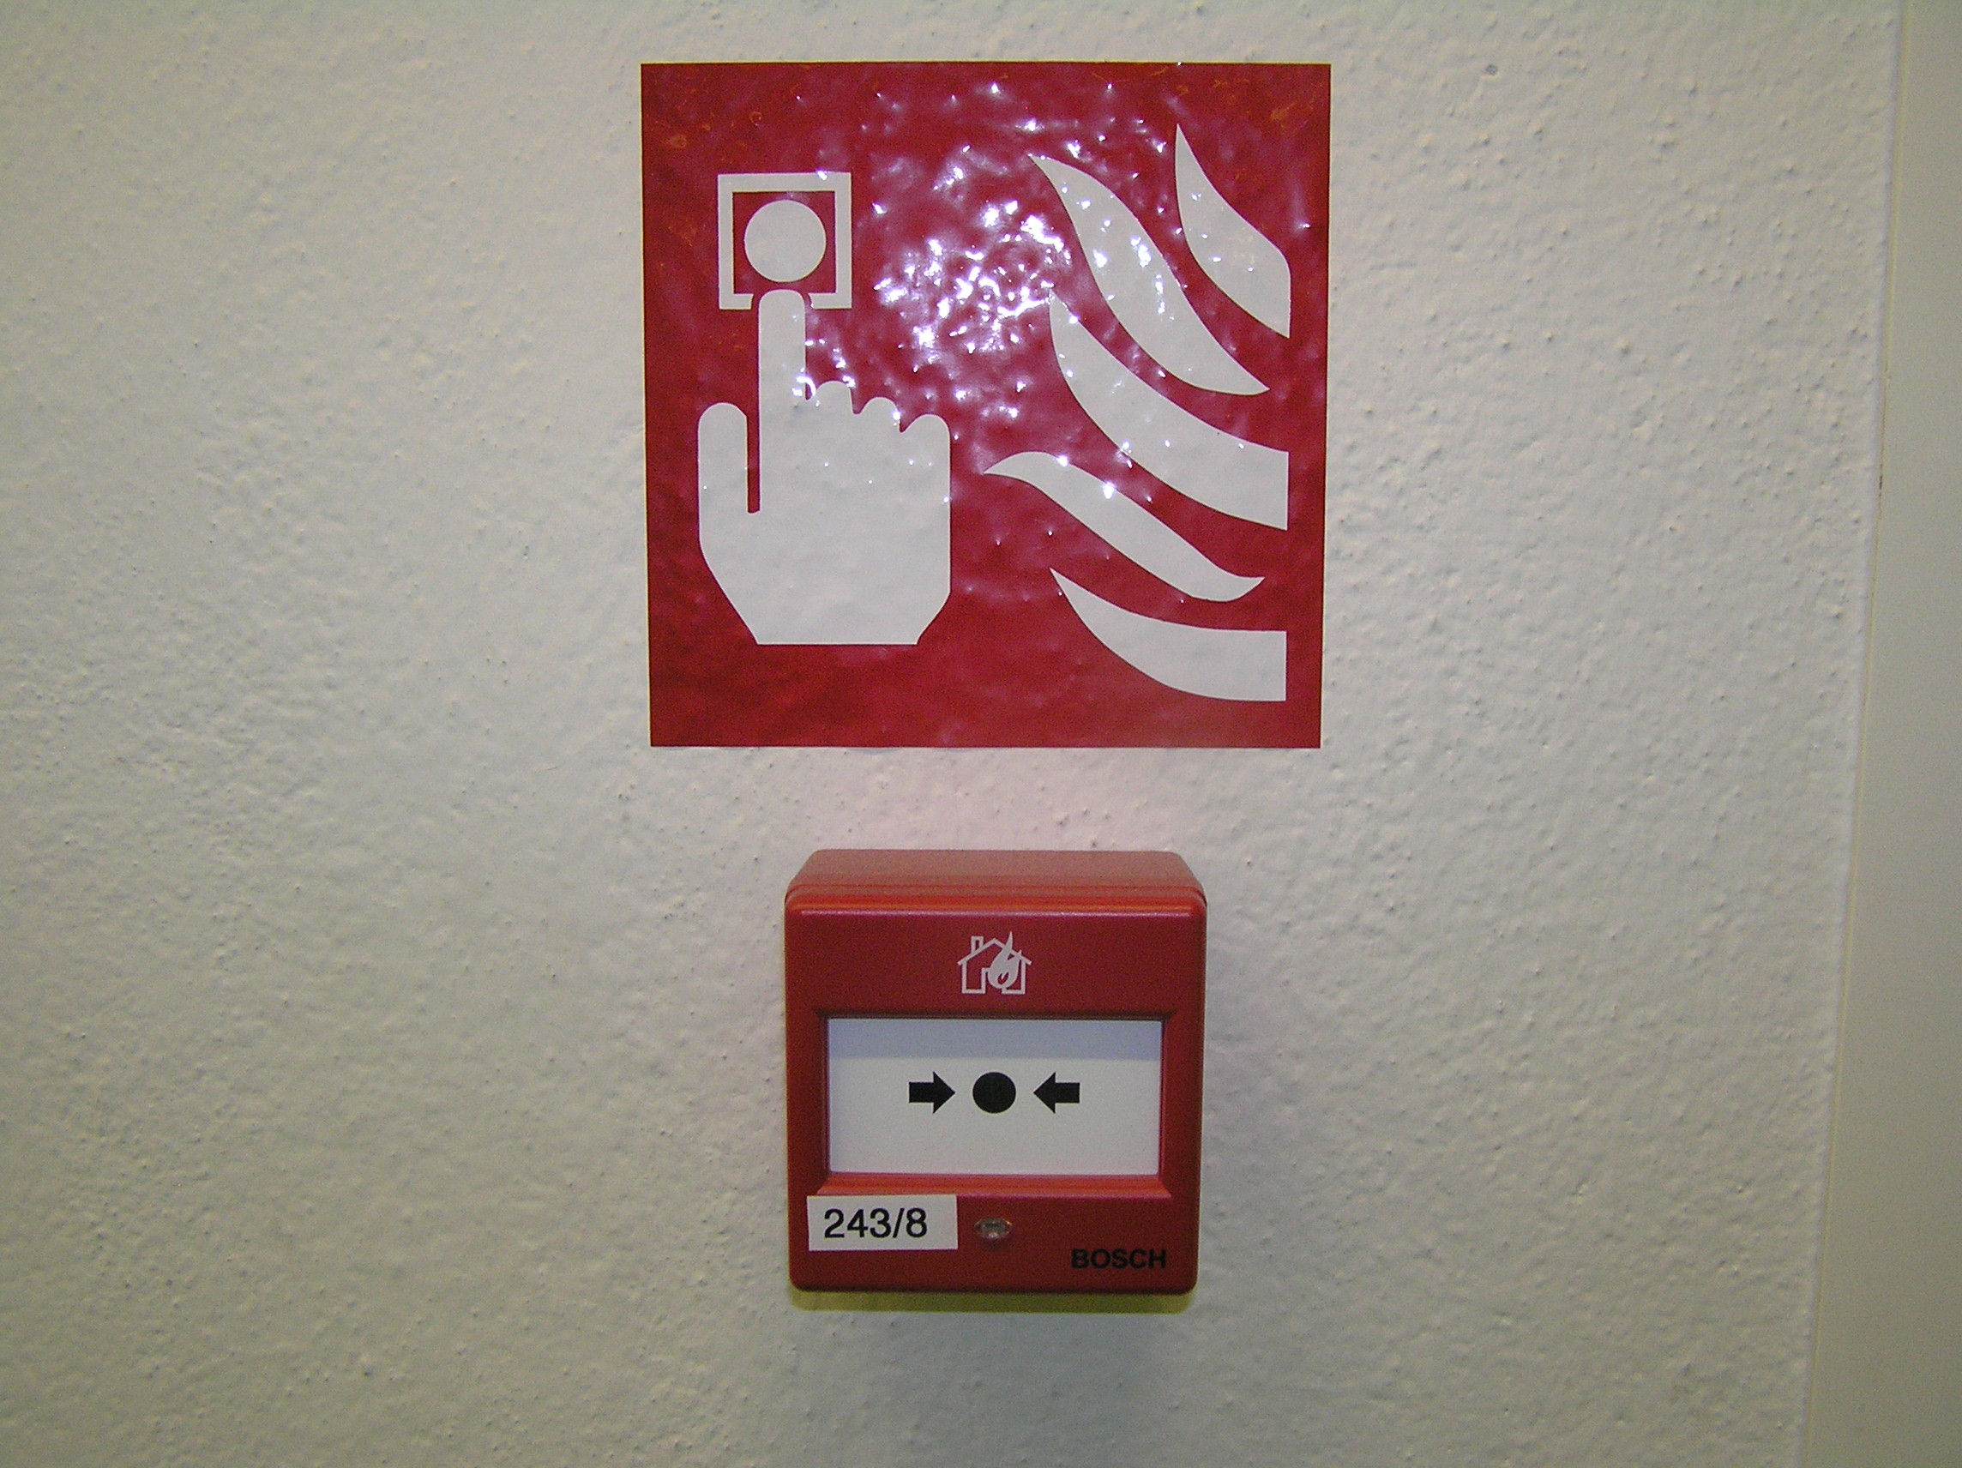
6.) Emergency (CHMS leak, fire, etc.)
Instructions for external companies
In case of emergency (hazardous chemicals leak etc.), the EC shall immediately inform the EC coordinator, who shall further follow the “Plan of Notification of the RBCB of Environmental Accident” (plan is on the board near enter of a hall)
Everyone is obliged to act in such a way as not to cause a fire
or endanger the life and health of persons and property.
Everyone is obliged in connection with fighting a fire to take the necessary measures to rescue endangered persons (injured, disabled), to extinguish the fire if possible or to take the necessary measures to prevent its spread, to report urgently to the designated place (fire reporting offices - gatehouses of the respective plants – next page) the detected fire or to ensure its reporting, to leave by escape routes to the assembly area, to provide personal assistance to the fire protection unit at the call of the intervention commander.

Slide 18
Instructions for external companies
Fire reporting:
- 150 (fire rescue service) or 112 (integrated rescue system) or activation of the fire alarm device button
- who is calling
- where from (company)
- place of fire (workshop, department, line …)
- what is in fire
- injured people
- to inform the relevant gatehouse of the exact location of the fire - where to navigate the fire rescue service, if possible to go to the relevant gateway and wait for the fire rescue service and to take the shortest way to the fire
- RBCB - gateway of the company RBCB “North“ – Emergency situations tel. 703 824 444
- Werk 2 - gateway of the company Aspera tel. 777 442 403
- Dubičné - gateway of the company Dubičné tel. 606 796 251
- to inform the fire rescue service commander upon arrival of the fire rescue service to the place of incident

Slide 19
7.) Alcohol and other intoxicating substances
Instructions for external companies
Alcoholic beverages and other intoxicating substances (e.g., drugs) shall not be brought onto the RBCB. Consumption of alcoholic beverages and other intoxicating substances (e.g., drugs) shall be strictly forbidden in the RBCB.
The EC coordinator shall be entitled to ask the authorized representative of the EC or by him authorized person to test use of alcohol and intoxicating substances at work. The EC staff shall be obliged to agree to random testing to detect alcohol or intoxicating substances. Minutes shall be taken about the test; in case of the positive result, the EC staff shall be ordered out of the RBCB premises.
Detection tube availability: - gateway north (24 hours a day)
- RBCB safety officer

Slide 20
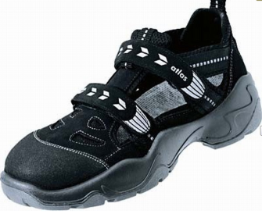
8.) Personal protective equipment
Instructions for external companies
During work use prescribe personal protective equipment.
Persons moving within production premises or nearby (such as laboratories, service workshops, warehouses etc.) shall wear prescribed occupational footware, min. category O1 according to ČSN EN ISO 20347 ed.2 (fully enclosed heel, closed-toe cap, and antistatic properties) among the others.

Slide 21
9.) Work accidents
Instructions for external companies
The EC employee shall report his work accident or witnessed work accident to his employer and HSE (for instance, via the EC coordinator), provided that such work accident has happened in the RBCB premises.
Subsequently, the external company shall solve its work accident independently, see §105 Labour Code No. 262/2006 Coll.
The RBCB shall assist in investigating such accident - contact person:
Soukup Petr RBCB/HSE
ATTENTION important! Do not change conditions at the place of accident!

Slide 22
10.) Medicine cabinets
Instructions for external companies
If the EC has a regular place of work at the RBCB, such workplace shall be equipped with the medicine cabinet.
The EC shall decide on contents of the medicine cabinet depending on the risk assessment.
The medicine cabinet shall not contain material after the expiration date, bandage materials shall be sterile.

Slide 23
11.) Traffic Operating Rules
Instructions for external companies
“RBCB Traffic Operating Rules” shall be followed unconditionally - traffic rules shall be followed and all users of roads in the EBCB shall be obliged to comply with these rules, safety and traffic signs, traffic light (the EF coordinator shall explain functions of the traffic light), signals, tables and to maintain discipline.
All means of transport (bicycles, transport carts (AMR), high-lift trucks and pull carts, carriages, personal cars and trucks etc.) shall comply with technical requirements laid down by the legislation of the Czech Republic.
Evaluate risks - inform other department, border space, wear warning vests, etc.
Walking:
  Always use pedestrian paths (pavements, zebra crossings and marked trails in the workshops).
  Driving:
  Comply with speed limits (25 km/h outdoors, 5 km/h indoors).
  Comply with parking prohibition outside reserved places (information at the RBCB gateway).
  Comply with no stopping rule in the entire premises of the RBCB except for loading/unloading only for the time necessary. However, even in this case vehicles shall not obstruct passage of other vehicles or pedestrians.
  Comply with ban to drive all transport means along green lines in the workshops.

Slide 24
Instructions for external companies
Attention:
  Roads outside in the RBCB shall be one-way roads; however, this shall not apply to high-lift trucks and train.
  Pedestrians shall have right of way on zebra crossings and pavements; however, high-lift trucks and pull carts shall have absolute priority in the workshops.
  EC vehicles shall be visibly identified in the prescribed manner - access permit (parking card) shall be visibly placed on the vehicle dashboard.
  Drivers of transport means shall be professionally qualified to operate such means, shall not smoke, shall not use telephone while driving and shall secure transport means against misuse by an unauthorized person/ againts spontaneous movement.
  High-lift trucks, pull carts and platforms of the external company shall be affixed with the name of the company.
  The “RBCB Traffic Operating Rules” shall not apply to special vehicles (IRS - fire fighters, first aid ambulances and police).
  Stop a transport vehicle in suitable place during the fire alarm, evacuation etc.

Slide 25
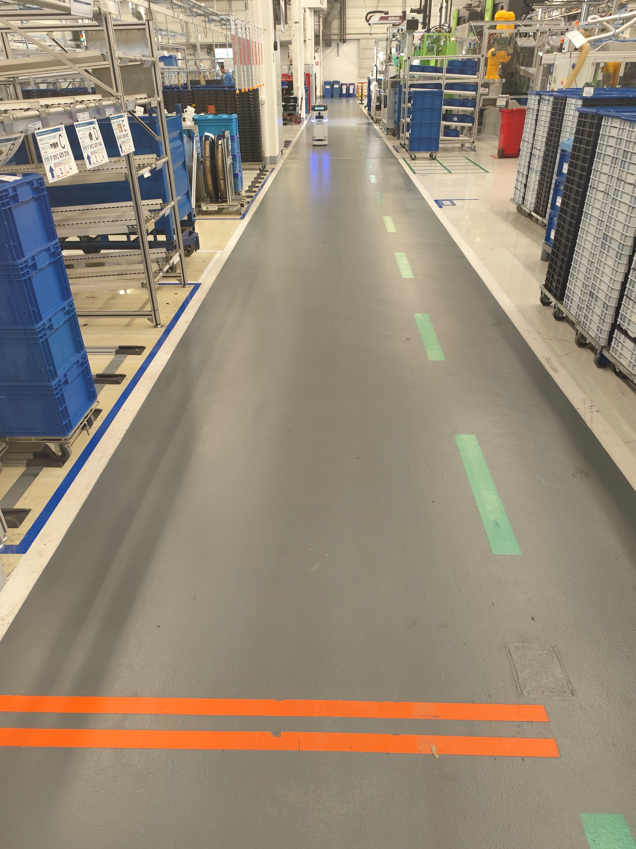
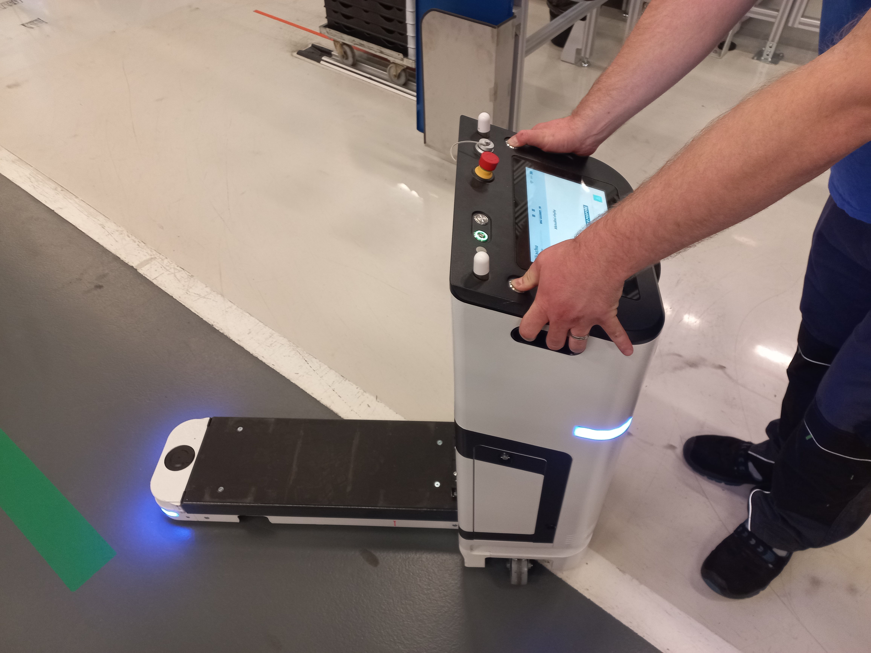
Instructions for external companies
Transport carts AMR (autonomous mobile robot) – video
- AMR may only be operated by a trained person
- in case of danger, use the "Emergency Stop"
(main switch, 2x release buttons, handles)
- do not enter the AMR protection area
(light on the floor)
- do not enter or drive into the orange-marked
lane if an AMR is moving there
- there is a risk of working at heights (the ladder,
etc.)
The AMR must not be used as a means of transport for people, etc. It may only be used for the transport of material intended for this purpose!!!

Slide 26
12.) Works at height
Instructions for external companies
Works above 1.5 m (measured from the floor level to the feet level) shall be considered as works at height and over free depth.
Observe Czech legislation, Government Regulation No. 362/2005 Coll. and local regulations.
For these works, measures must always be taken to prevent the fall of workers, material, tools, suitable PPE according to applicable legislation / instructions from the manufacturer / risk assessment (e.g. protective helmet with a chin strap on), etc. to avoid personal injury or damage property of RBCB. It is forbidden to work over other workers or communications. The EF coordinator with EC and coordinator of concerned department shall define measures (suspension of operation, demarcation the hazardous area, separation of the persons/transport, covering of machinery etc.).
On flat roofs (under 1.5 m from the free edge of roof – use the catch system), by open/unsecured holes (doors) etc. always use a catch system together with fall protection. Notify

Slide 27
Instructions for external companies
When working at heights on the galleries in the halls use a light mobile scaffolding equipped with a railing or other fall protection.
Only scaffolding, bridges and platforms whose metal parts shall not come in touch with the floor, facade or other parts of the objects shall be used.
Mobile devices shall always have rubber or plastic wheels.
Do not hang other structures on piping, electrical trays, air conditioning, cranes, etc.

Slide 28
13.) Ladders
Instructions for external companies
All ladders and steps shall be labelled to clearly identify their owner.
When working on a ladder, the employee must be secured against falling with personal protective equipment (e.g. helmet with put on chinstrap) in cases where his feet stands at a height of more than 5 m. (Or if the depth below it is greater than 5 meters- galleries, etc.) Use suitable PPE also for lower heights according to the risk assessment.
Upon request the EC shall submit a proof of completed inspection of the specific ladder.
Ladders shall be in perfect technical condition.
Materials, tools, etc. must be secured against falling
According to the risk assessment space around/under the place of work must be secured, also surrounding area – e.g. separating of persons / transport, delimiting the hazardous area.

Slide 29
14.) Cranes and other lifting equipment (ZZ)
Instructions for external companies
External company can use cranes or other lifting equipment owned by RBCB only by EC operators with valid license/relevant authorization/training, valid class of lifting equipment, with the approval of the authorized manager/technician of lifting equipment. They must be trained from the special RBCB regulations for lifting equipment, manufacturer's manual of lifting equipment and other instructions.
The use of lifting equipment owned by EC in the RBCB premises must be reported in advance to the authorized manager/technician of lifting equipment of RBCB. The EC operators of lifting equipment have to have valid license/relevant authorization/training, valid class of lifting equipment,etc. and valid revisions/check of lifting equipment etc.

Slide 30
15.) Lifting equipment - lifting platforms (LP)
Instructions for external companies
Comply with applicable legislation, manufacturer's instructions, internal regulations
LP must be clearly marked by owner of LP and by user. It must always be secured against unauthorized use of the LP and with valid revision/check.
The LP operators must be trained from the special RBCB regulations of lifting equipment, manufacturer's manual of lifting equipment, other instructions, with valid license/relevant authorization/training, valid class of lifting equipment, with the approval of the authorized manager/technician of lifting equipment of RBCB.
The operators on lifting platform (above 1,5 m height) must always secure themselves against falling (e.g. a rope of the appropriate length and a carabiner, etc.) and use the prescribed PPE (protective helmet with put on chinstrap).
The space around/under the place of work must be secured, also surrounding area – e.g. separating of persons / transport, delimiting the hazardous area.
During work, one operator will always be present at the lower workplace who must be familiar with the manufacturer's manual of the LP and will have the appropriate PPE (e.g. helmet).

Slide 31
16.) Handling of Bulky Loads
Instructions for external companies
Unloading of machinery, switchboards, parts of air-conditioning units etc. from trucks with high-lift trucks or crane, other lifting equipment (point 14-15).
Handling in the competence of the external company. If the RBCB staff participates in the handling procedure, they shall be obliged to follow instructions of the EC staff.
The operator of the high-lift truck or crane shall hold relevant qualification to operate such means.
If the load must be tied or untied, a competent person (slinger), holding relevant qualification, shall carry-out such activity,

Slide 32
Instructions for external companies
The staff, moving around the load, shall wear personal protective equipment (helmet, occupational footwear etc.) and their identification shall be easy (reflective vest).
Access of unauthorized persons and access of transport means, whose activity shall not be connected with the handling, shall be forbidden in the working area (i.e., under suspended or lifted load or immediate vicinity).
Loads shall not be transported over other staff (or any other people) or in the immediate vicinity.
All staff shall keep a sufficient distance from the handled load. The load shall not be supported, balanced etc. by hands.

Slide 33
17.) Charging station
Instructions for external companies
If the EC operates a charging station in the premises of the RBCB (an opened area reserved and adapted to recharge batteries, the space may also be used for battery maintenance):
no flammable material shall be stored within the radius of 1.5 meters from the charging station; or such space shall be separated from the battery by a fireproof barrier.
Lead-acid accumulators, Ni-Cd, NiMH, etc.
The workplace shall be well ventilated, marked with safety warning signs; fire extinguishers shall be located nearby.
The staff, handling with batteries, shall wear personal protective equipment (goggles or face shield, rubber gloves etc.) depending on the risk assessment.

Slide 34
18.) Works on electrical appliance
Instructions for external companies
Passages of cables through door and window openings - use a red double-layer cable protector with a length of at least 1 m!

Slide 35
18.) Works on electrical appliance
Instructions for external companies
Before the start and after the completion of works on the electrical equipment (EE) in the ownership of the RBCB, the EC job manager shall inform the EC coordinator. Hand-over and acceptance of the workplace, involving electrical works, shall be in writing.
The job manager shall be appointed for each work involving electricity – „ Lead Electrical Engineer" according to §7 of Government Regulation No. 194/2022 Coll.as amended, with the final responsibility for working activities carried-out on the EE.
Works on live low voltage circuits shall be forbidden in the RBCB.
Works on el. switchboards without knowledge of FCM department shall be forbidden.
Upon request, the EC shall submit a proof of completed valid electrical revision of the equipment in the ownership of the EC; furthermore, such equipment shall comply with valid regulations.
The external company shall be responsible for the fact that the staff making electrical works shall hold necessary professional qualification according to Government Regulation No. 194/2022 Coll.

Slide 36

19.) Explosion hazard premises
Instructions for external companies
To prevent formation of an explosive atmosphere.
Places, where formation of an explosive atmosphere can not be excluded, shall be separated and labelled with the safety warning sign.
To fill in, with the EC coordinator, the so-called hot work permit “Order V” (government decree No. 406/2004 Coll., on Detailed Requirements on Occupational Health and Safety in the Explosion Environment, familiarize with special documentation about explozive area in RBCB).

